Slide 1
Literature development CH. 1-6
BY KATIE FRENCH
AP AMERICAN HISTORY PERIOD 6

Slide 2
Western African Folklore
  Islamic influence present in many texts from the Sudanese
  First writings religious poetry
    Abdullah ibn Muhammed Fudi
      Wrote about wars and kings in West Africa in 1200s
      Focuses on Songhay dynasties history (written in Arabic)
        Mali Empire
        Tuareg

Slide 3
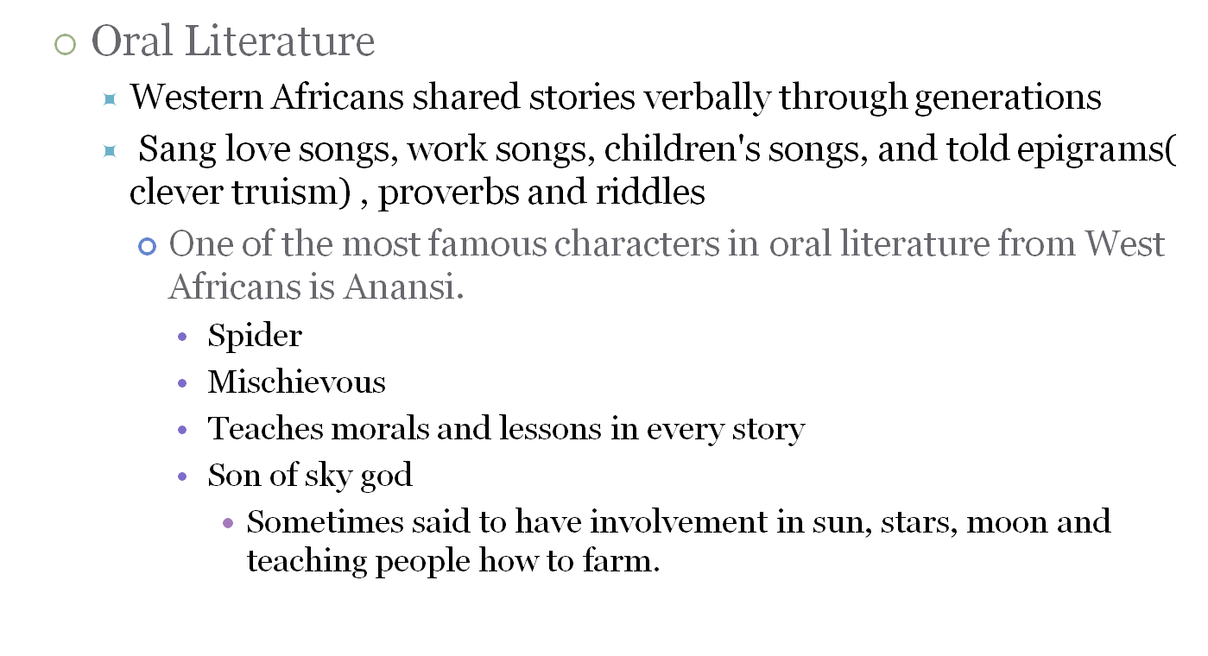
Western African Folklore (Con’t)

Slide 4
Native American folklore
  Often teach a moral or provide creation mythology
  Told through generations
    Person usually chosen to make sure the stories were passed along
      Having a good memory was respected in the Seneca group.
  Frequently related to environment or animals
    How to find happiness
    How animals live in a multitude habitats
    Stories connecting to faith
      The buffalo and the field mouse
      ‘If you are proud and selfish you will lose all in the end’

Slide 5
European Literature
  Thomas More
    Involved in politics, eventually involved in reformation and is executed
    Wrote Utopia
      Based on his idea of a perfect society
        Fair society with everyone’s group effort creating world

Slide 6
European Literature
  Niccolò Machiavelli
    Was once a political leader
    Was exiled
    Wrote The Prince
      Explains why abandoning morals and religion for the state is ultimately beneficial.
        ‘All is far in love and war’
      Reflects time period- focus on God, gold and glory. Everyone interested in conquering and maintaining power during the age of exploration.

Slide 7
European Literature
  Francis Bacon
    Accredited with creating the modern essay
      Known for being satirical, with dark wit and annoyance towards society
  William Shakespeare
    Wrote about 36 plays and poems
      Most celebrated works- Romeo and Juliet, As you like it, A midsummer's night dream, the tempest and MANY others.
      Wrote histories, comedies, tragedies, poems
        Apocrypha- some plays authors are not solidified

Slide 8
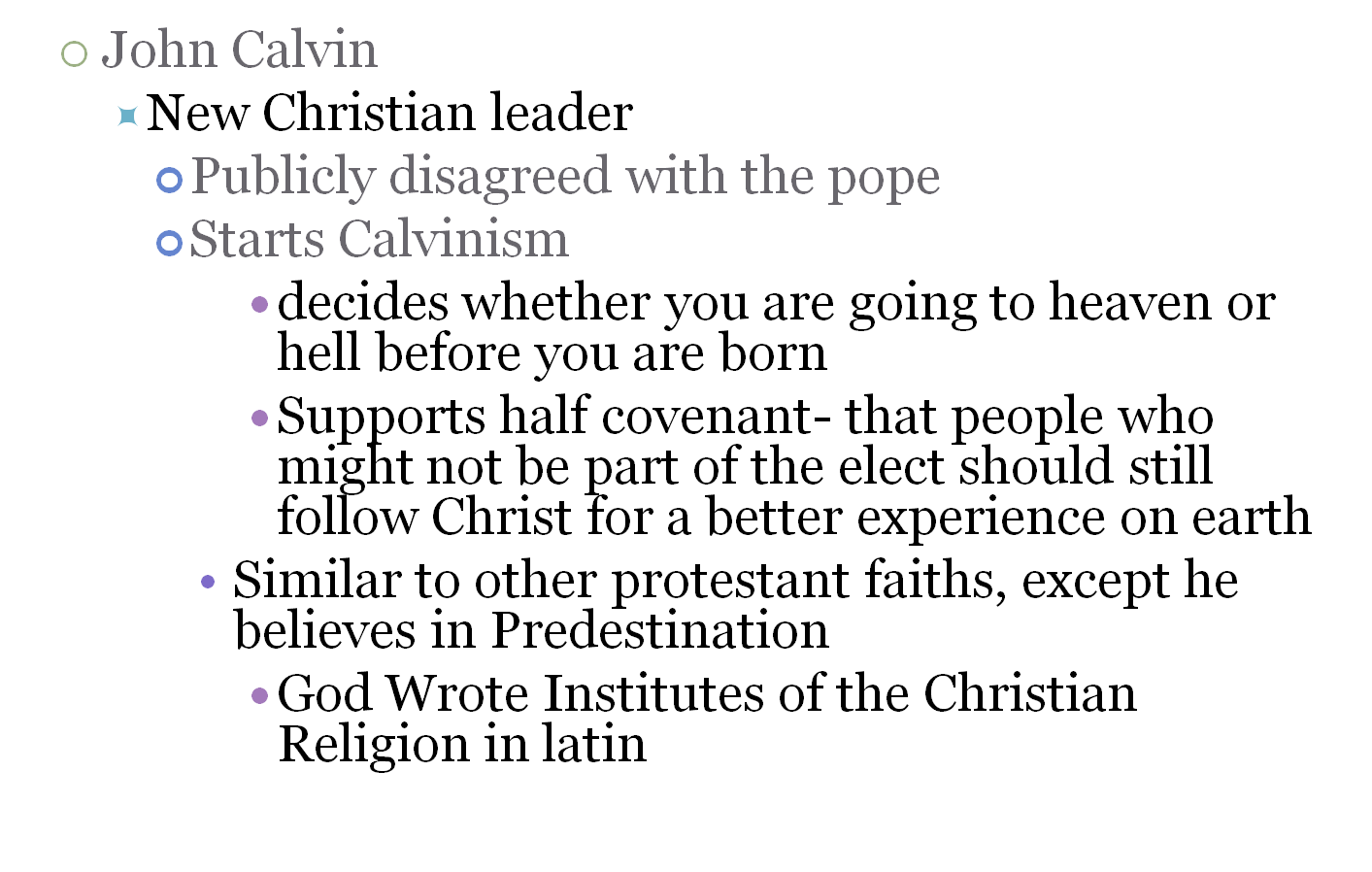
European Literature

Slide 9
The renaissance authors
William Shakespeare(1564-1616)
Writing works including Romeo and Juliet, Macbeth, a midsummer’s night dream, As You Like It, Hamlet, King Lear The Tempest and much more. Writing sonnets, plays and creative insults, Shakespeare added new words to the dictionary (see lonely) and captured his time period through comedy, drama, and wise observations. Shakespeare was adored by Queen Elizabeth, who often came to see his plays and was a leader of England’s exploration.

Slide 10
Columbus
Conquering Hispaniola and returning with more people to capture slaves less than a year later, Columbus was the first European to make sustained contact with the Native Americans. He wrote a book of his explorations, an incredibly important document that supports the immediate disrespect Europeans had towards native Americans. One of Columbus’s first thoughts is to enslave these exotic people groups. His book Travels has aided historians greatly in understanding the European perspective towards Native Americans, whom they would eventually enslave.

Slide 11
Sonnet!
Guess what?

Slide 12
Sonnets
a poem that is 16 lines long separated into 4 parts.
Shakespeare eventually makes his own sonnet form

Slide 13
Rhyme royal

Slide 14
Ryme royal
Shakespeare often used this rhyme scheme. It goes ababbcc

Slide 15
Vocabulary
  Iambic
  Pentameter

Slide 16
Vocabulary
syllables collecting in groups of 5 in a Shakespearean Sonnet.

Slide 17
Vocabulary
tragedy

Slide 18
Vocabulary
Playwrights including Shakespeare loved Tragedy’s during the age of exploration. Always ending badly for the characters, authors often have intense foreshadowing.

Slide 19
Vocabulary
ESSAY

Slide 20
Vocabulary
a document that discusses an idea or explains a theory. It is not set up to be a read as a book and has little division between points aside from indentation.

Slide 21
POP QUIZ!
1) Who is Shakespeare?
  a. poet and playwright b. a president c. King d. philosopher
2) What Ruler in England appreciated Shakespeare’s works?
  a. King Henry IV b. Queen Elizabeth I c. Philip V d. Queen Katharine
3) What do most Native American stories possess?
  a. explanation of nature b. baboons c. cathedrals d. the devil
4)What did Columbus write about?
  a. The horrible treatment of slaves b. genetics c. the ‘blank slate’ theory d. his experience in the new world
5. What did African folklore rely on as a form of discussion?
  a. written language b. oral stories c. European influence d. Native American folklore

Slide 22
POP QUIZ!
Who is Anasia?
  a. water goddess b. tricky African spider c. a the name for Lord in present day Uganda d. a made up monster to scare Native American children into behaving
7) What do Western African stories tend to focus on?
  a. God intervening b. sports c. trickery and learning lessons d. slavery and oppression
8) What religion was focused on primarily in areas like Sudan during the age of exploration?
  a. Islam b. Christianity c. Zoroastrian faith d. Judaism
9) Who started Calvinism?
  a. Margret Calvin b. Peter Calvin c. Paul Luther d. John Calvin
10) How do people in modern day know Columbus’s intentions to enslave the native Americans he met in Hispaniola.
  a. Columbus’s writing b. The card game rules reflected dislike towards native Americans c. an escape letter written by a Mayan slave to his family d. Treaties written by Native Americans about the inhumanity of slavery

Slide 23
American Literature1776-1824 chapter 7,8,9
1. A
2.A
3.A
4.D
5.B

Slide 24
Answers!
6.B
7.C
8.A
9.D
10.A

Slide 25
Printing and American publishing begin
  Puritans start a college and a printing press in Cambridge, who started printing psalms and other religious
  First book printed in German
    Political advancements by English speakers cause printed materials in English
    In England, widespread printing was delayed, while printing in the colonies didn’t have location boundaries.
    Cambridge and Boston to New York, Philadelphia, and Annapolis were hot spots for printing with about 250 separate items being printed from 1696 to 1700.

Slide 26
Colonial Literature
  Pamphlets made for European and new settlers to read become very common.
    Captain John Smith penned ‘A True Relation of Such Occurrences and Accidents of Noate as Hath Happened in Virginia...’ in 1608 about his experience with Powhatan, a Native American tribe leader.
    Many key political figures wrote political writings concerning american identity including: Samuel Adams, Josiah Quincy, John Dickinson and Joseph Galloway
    Franklin's Poor Richard's Almanac and The Autobiography of Benjamin Franklin were quite influential.

Slide 27
Religion usually reason for literature
    John Winthrop- church leader who wrote The History of New England, explaining the foundations of the Massachusetts Bay Colony.
    Edward Winslow- kept a diary that explained the mayflower settlement’s first few years.
    Increase Mather- A Puritan minister- involved with the government, administration of Harvard College, and heavily involved in the Salem witch trials.

Slide 28
Social issues confronted
  Slavery
    1700- Judge Samuel Sewall publishes The Selling of Joseph, an antislavery work.
  People focused on enlightenment in the 18th century
    Works focus on the individual, and choice instead of church led ideals. Earlier authors who promoted the separation of church and state also see a separation in literature between religious and secular works.
  Freedom of speech
    1734 John Peter Zenger, editor of the New York Weekly Journal, sent to New York prison since he upheld freedom of the press.

Slide 29
Anne Bradstreet
arguably the woman to start American women literature, Anne Bradstreet gained fame within her strict community through her beautiful love peoms to her husband. Anne acts a vivid contradiction to assumptions about marriage within the puritan community, and was able to gain respect independently for her talent.

Slide 30
Increase Mather
A puritan minister who wass involved in a plethora of things including education and government. As an administrator of Havard College and was infamously involved in the Salem Witch trials . He was a ‘political animal’ being so embedded in the community and was a man to be feared and respected.

Slide 31
POP QUIZ!
1. Where did the puritans start a college and?
Boston b. Kansas c. Philadelphia d. Cambridge
2. What language was the first book published in the new world written in?
a. Italian b. Portuguese settlers’ c. English authors d. Germans
3. Which of the following locations was NOT a ‘hot spot’ for printing?
a. Cambridge and Boston b. New York c. Canada d. Philadelphia
4. About how may items were printed from 1696 to 1700
a.250 b.500 c. 1,000 d. 1,300

Slide 32
POP QUIZ!
5. Who wrote ‘A True Relation of Such Occurrences and Accidents of Noate as Hath Happened in Virginia...’?
a. John Smith b. John Wright c. Jacob Left d. Joseph Smith
6. Who was John Winthrop?
a. church leader who wrote The History of New England, explaining the foundations of the Massachusetts Bay Colony b. philosopher c. psychologist d. historian
7. What was The New English Canaan by Thomas Morton, about?
a. being against slavery b. made fun of settlers and preferred the native Americans to the British
c. water d. the English government

Slide 33
POP QUIZ!
8. What was the Selling of Joseph about?
a. indentured servants b. terrorists c. slavery being horrible d. the cost of liberty
9. Why was John Peter Zenger imprisoned?
a. he upheld freedom of the press as editor for New York Weekly Journal b. anti-religion comments c. anti- loyalist commentary d. he started the Boston massacre
10. What effect did the enlightenment in Europe have on American Literature?
a. None b. people become more focused on the individual and ‘the dignity of man’ type of thought c. Everyone started calling themselves ‘flames’ to recall Voltaire d. people strictly read pamphlets

Slide 34
POP QUIZ!
1.d
2.d
3.c
4.a
5.a
6.a
7.b
8.d
9.a
10.b

Slide 35
Extra Questions
Who is Anne Bradstreet?
  A. Hooker B. Witch C. Muse of a famous poet D. a famous writter
Why did the Puritans support education?
  A.Education was part of their faith—being able to read B. It made slaves look immoral because wisdom and morals were seen an interchangeable C. It was the best way to rebel against Catholics D. It made them look more intelligent then other denominations
How come most things published were religious?
  A. Religion was the focus of society B. America was a united theocracy C. people needed stability and hope desperately D. The purpose of all colonies was to minister
What genre did Anne Bradstreet write in?
  A. Satire B. Poetry C. Plays D. psychological thrillers
How did writing from this time influence what society thinks today about American beginnings
  A. They assume religious groups were stricter than they were B. The y assume the society of friends were terrorists C.people thinks slaves were more common then they were D. Concubines were frequent in nobles homes

Slide 36
Extra Answers
D
A
A
B
B

Slide 37
Revolution effects literature
  Poems and songs
    Become tools for patriotism!
      Yankee Doodle
    Philip Morin Freneau- boat captain, poet and news paper editor.
      Poem The House of Night one of the first romantic poems
      His writing was dark like Edgar Allen Poe
Considered a forefather of the Transcendentalist movement

Slide 38
John Trumbull
      Wrote satirical poems.
      Elements of romanticism and Neoclassic literature
        Neoclassic literature involved rationalism, classical imitation, good taste, formalism, and educational entertainment.

Slide 39
Francis Hopkinson
      had funny titles for his writing
        ‘The Miscellaneous Essays and Occasional Writings of Francis Hopkinson’
        A Pretty Story Written in the Year of Our Lord 1774
        Collection of Plain Tunes with a Few from Anthems and Hymns.
      Wrote essays, poems and even composed music!
      Claimed to have designed the first American flag

Slide 40
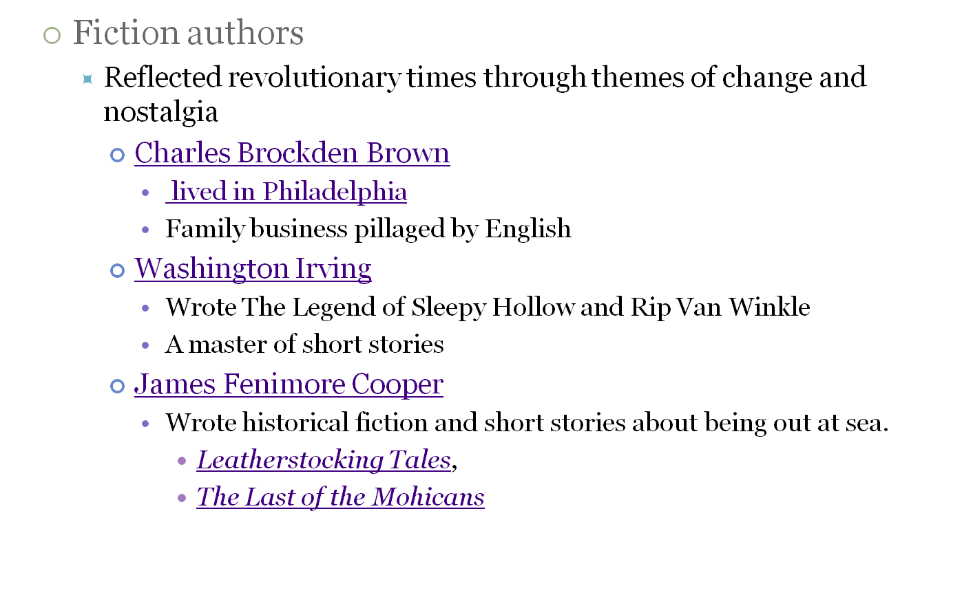

Slide 41
  Continued shift from literary focus from god to individual
    Communities growing lead to a stronger interest in society and individuals
      In the past, small groups were generally together for religious reasons- as the population grew, communities became more diverse and interests varied- economic roles are key. This lead to church’s weakened power over community.
    After scientific understandings like the laws of physics, man becomes increasingly confident in their personal potential.
    Enlightenment ideas act as a linchpin
Benjamin Franklin’s Autobiography instills idea man makes his destiny

Slide 42
Benjamin Franklin
wrote under a fake name for much of his career. He had a talent in utilizing folk phrases in his works. He’s an important person because of the role his writings played in the turn from the church and towards individuals, as seen in his famous ‘the way to wealth’ as well as his autobiography.

Slide 43
Edgar Allen Poe
he was a huge leader in the romanticism movement and was an idol for many American authors with his very dark, detailed style of writing.

Slide 44
POP QUIZ!
10 multiple choice
1. Yankee doodle was a
  Song b. short story c. picture book d. slogan for the revolution
2. The enlightenment took place in
  Kenya b. Japan c. France alone d. Europe
3. Overtime, writing changed from being focused on theology to focusing on
  geography b. statistics c. gravity d. individuals power and choices
4. True or false: Benjamin Franklin wrote a play called ‘As we’ve seen’, focused on American oppression by the british
  true b. false

Slide 45
POP QUIZ!
5. What genre is Washington Irving best known for?
a. satire b. horror stories c. romanticism d. short stories
6. Which description is not related to Satire?
a. always meant to be performed on stage b. meant to poke fun of society c.meant to provoke change d. can address serious topics
7. Who wrote The Last of the Mohicans?
a.Benjamin Franklin b. James Fenimore Cooper c. Charles Brockden Brown d. Washington Irving

Slide 46
POP QUIZ!
8. Charles Brockden Brown wrote
a. satire b. fiction c. pamphlets d. philosophy
9. Which of the following did Francis Hopkinson not write?
a. essays b. epics c. composed music d. poems
10. Which author was a boat captain?
a. Charles Brockden Brown b. Francis Hopkinson c. Philip Morin Freneau d. John Trumbull

Slide 47
ANSWERS!
1.A
2. D
3. D
4.B
5. D
6.A
7. B
8. B
9. B
10. C

Slide 48
Satire
    Definition: genre aimed at provoking (or some say, preventing) change. Often uses outlandish examples to make people at themselves and notice an issue in society. Ranges from juvenalian, a non-threatening, light hearted and foolish tone to a Horatian tone- where death, human right violations and other horrible and tragic are mocked.

Slide 49
Short Story
Stories less then 40 pages which can be read in one sitting.

Slide 50
Romanticism
Dark, detailed, depressed style seen in poetry and novels/ short stories from revolutionary times onward.

Slide 51
Enlightenment period
A time in European history where philosophies about government, rights and ability of man are the main focus. Main philosophers include Voltaire, Locke and Hobbes. Social contract, natural rights and autonomy rule this time.

Slide 52
Fiction
A story that is not based on a particular reality and has not occurred in real life.

Slide 53
References
Faragher, J. M., Buhle, M. J., Czitrom, D., & Armitage, S.H. (2002). Out of Many, A History of the American People. Upper Saddle River, N.J.: Prentice Hall.
Edward Simonds(2010). A Student's History of American Literature.Howto.org

